Slide 1
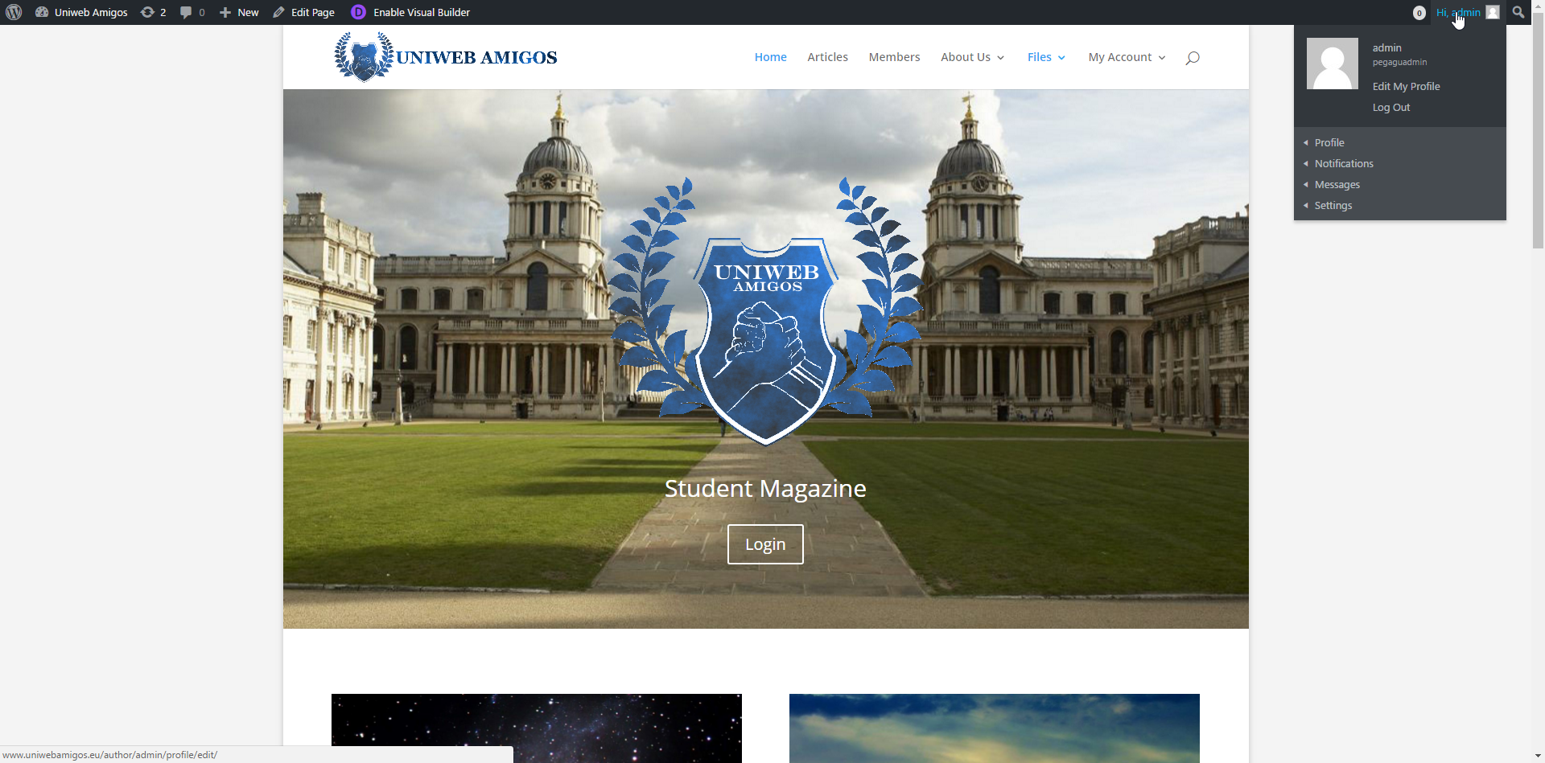
Dashboard to personal profile, notifications, messages and settings.
Dashboard to the Website control.
Can edit pages or posts directly from each page or post.

Slide 2
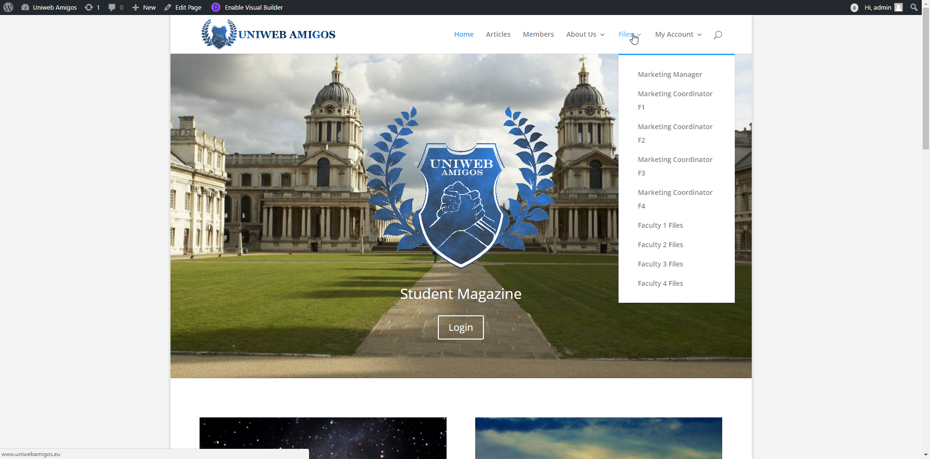
All menus and all links visible and accessible to Master Administrator

Slide 3
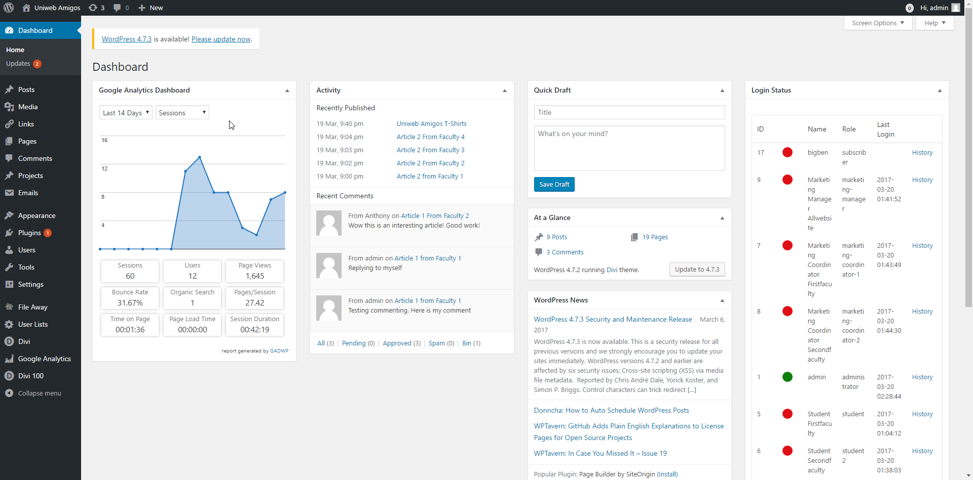
Google Analytics,
Latest activities – latest published articles and comments,
Login Status history.

Slide 4
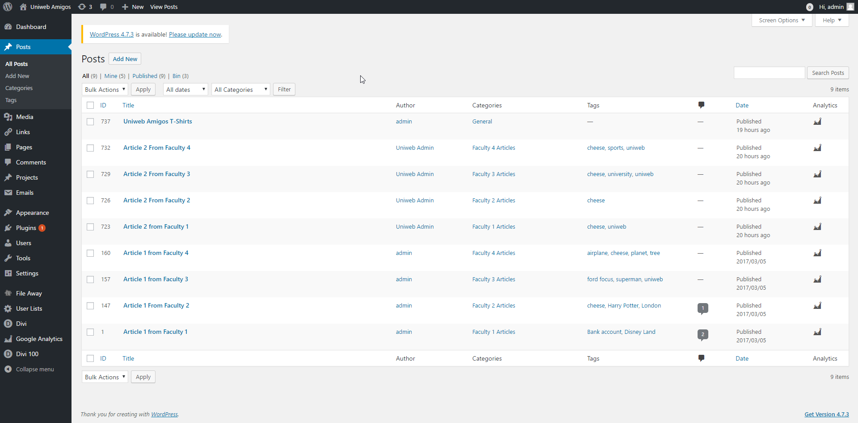
Posts page: can create, edit, delete posts.
See who is the author, check the number of comments.
Check the Google analytics data for each posts.

Slide 5
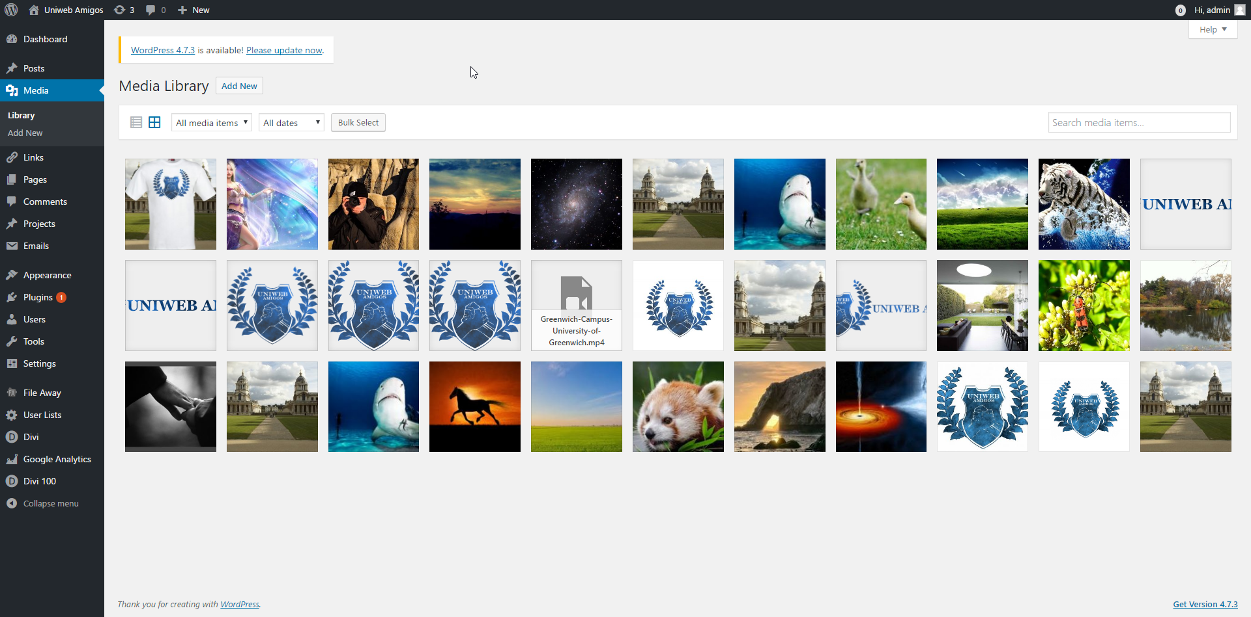
Media Library access: can add new files, edit and remove files.
These files are only used for the website itself, posts and pages.
Unpublished student files are not available for admin here.

Slide 6
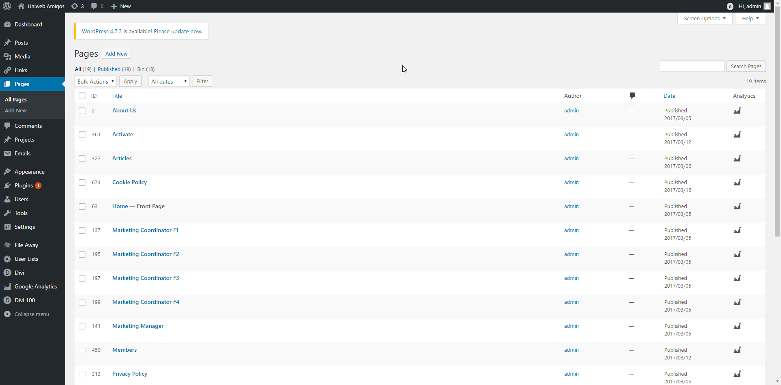
Pages access: can create new, edit or delete current pages.
The whole website layout and design is created in this place.

Slide 7
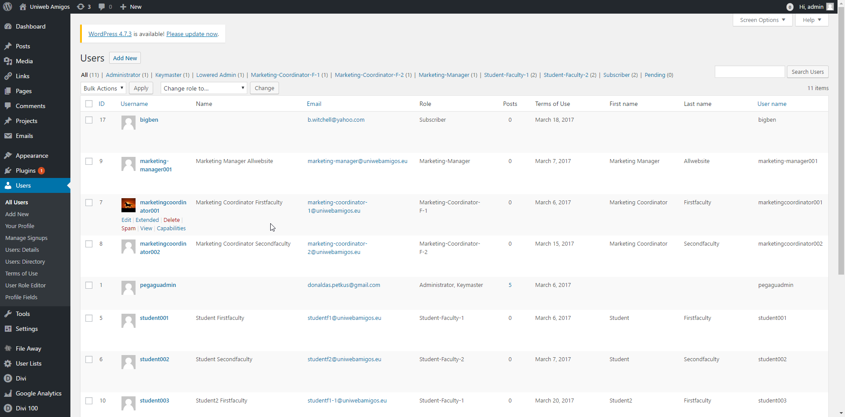
Administrator has access to Add new, Edit or Remove users.
Change user roles.

Slide 8
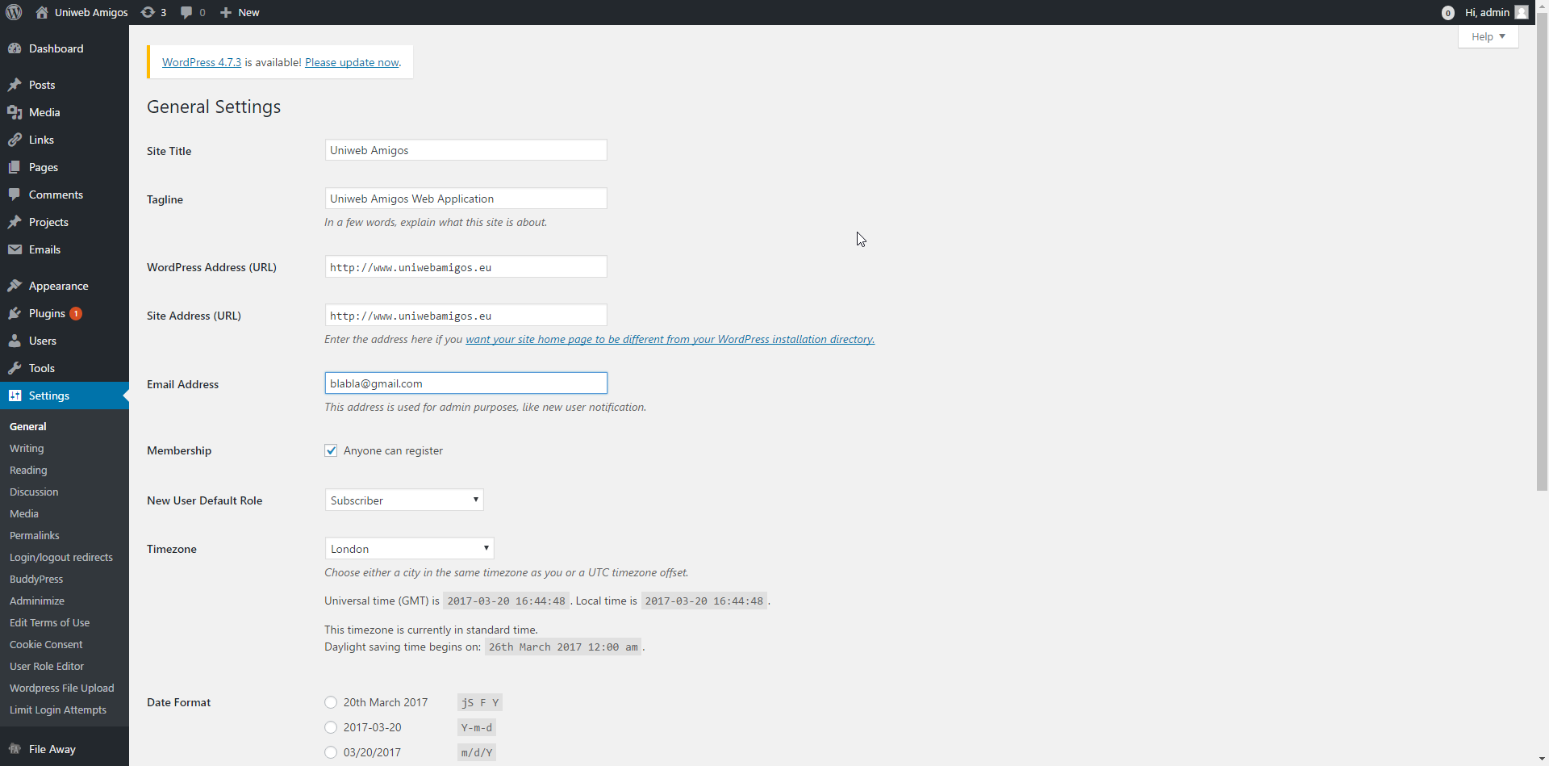
General settings.
Change website tittle, allow/disallow for users to register, change time zone, time format.

Slide 9
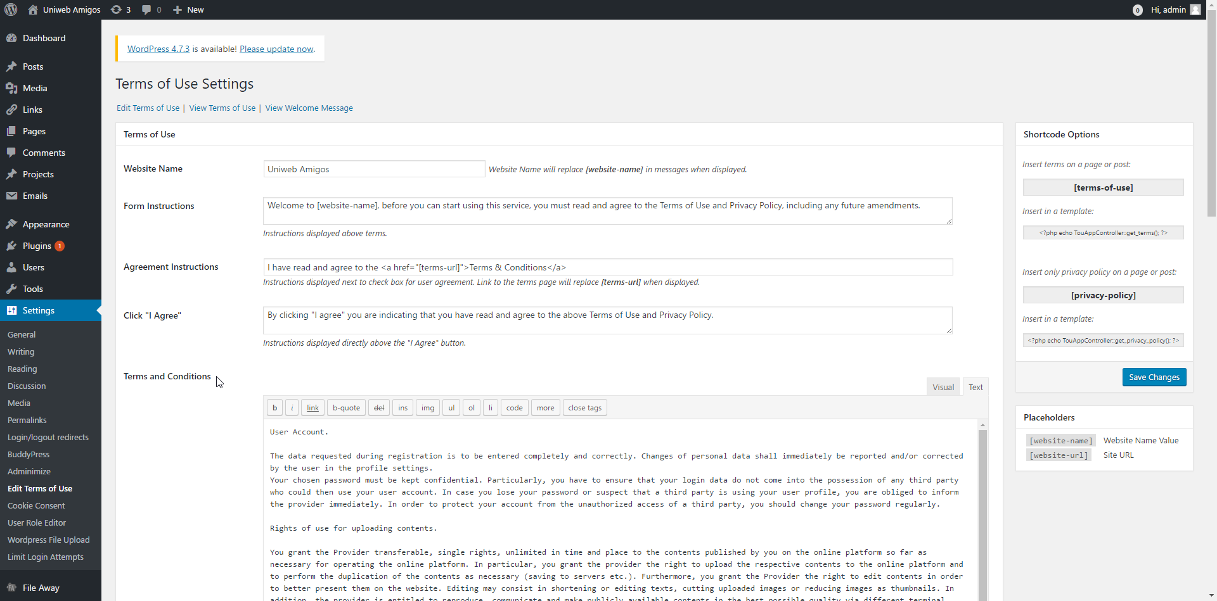
Administrator has access to Terms & Conditions and Privacy Policy pages and can adjust them if required

Slide 10
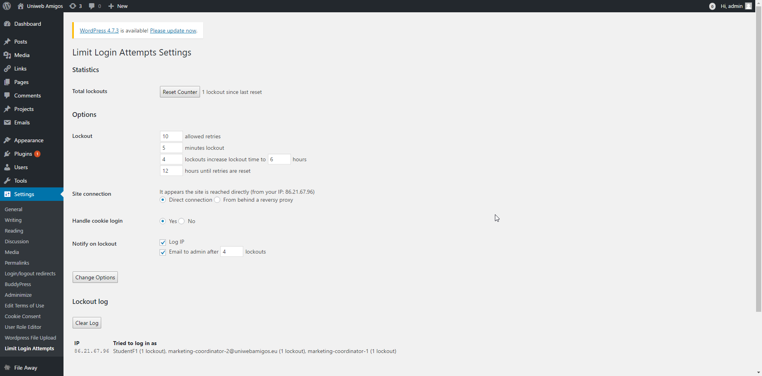
Access to Website security.
Username / Password guessing bots or humans will be locked down

